Slide 1
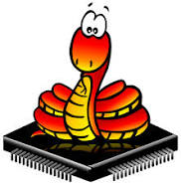
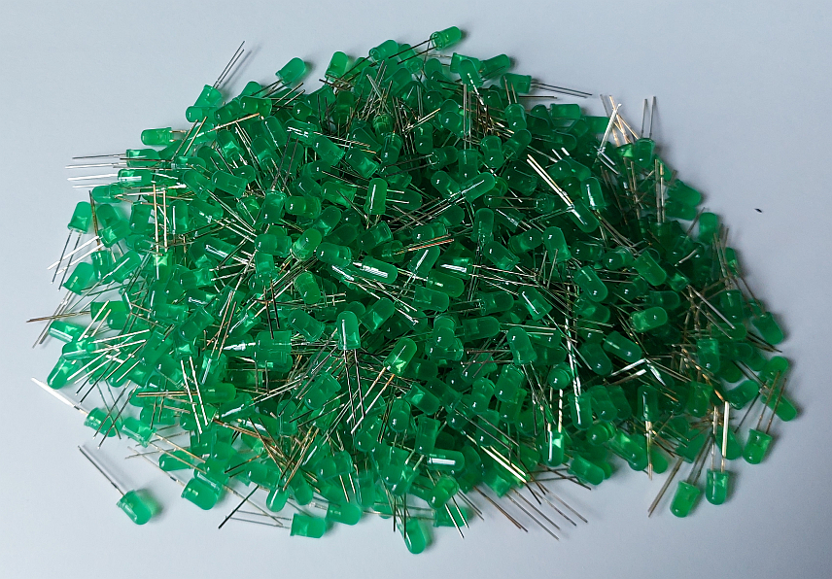

MORE LEDs!
A quick introduction to MicroPython, RP2040 PIO, HUB75
MicroPython
https://micropython.org
Wouter van Ooijen
wouter.vanooijen@cboost.nl

Slide 2

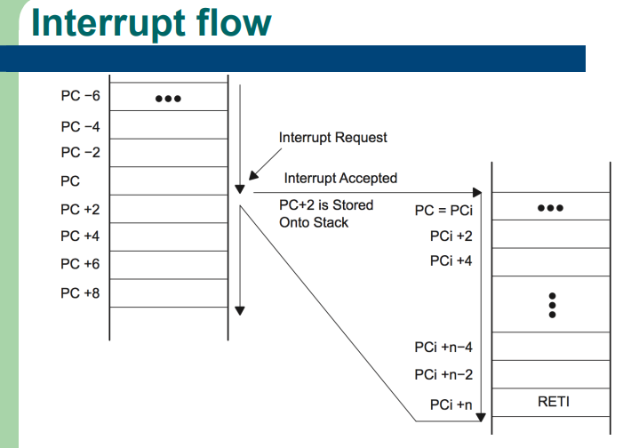
Questions are welcome
Over lunch

Slide 3
Me
TU Delft Informatica 1988
ICT Automatisering
VAX11 industrial datacommunication
@ Fokker Space / Dutch Space: Era Robotic ARM
@ Hollandse Signaal / Thales: SmartNet ATM comms system
VOTI webshop, self-employed (NLR), projects
Hogeschool Utrecht, Breda: lecturer Technische Informatica
C, C++, assembler, Python, SE, electronics
Cboost
embedded specialist
Who cares
Wouter van Ooijen
wouter.vanooijen@cboost.nl
Programmer by profession, electronics tinkerer by passion

Slide 4
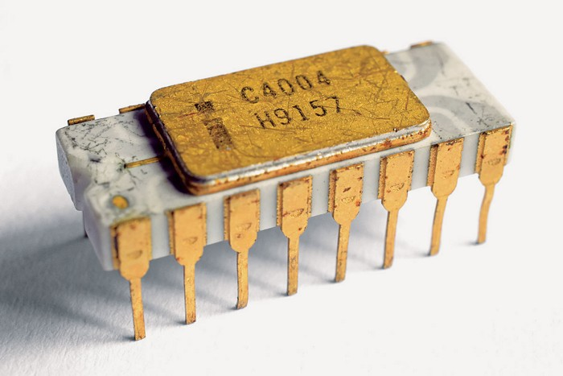
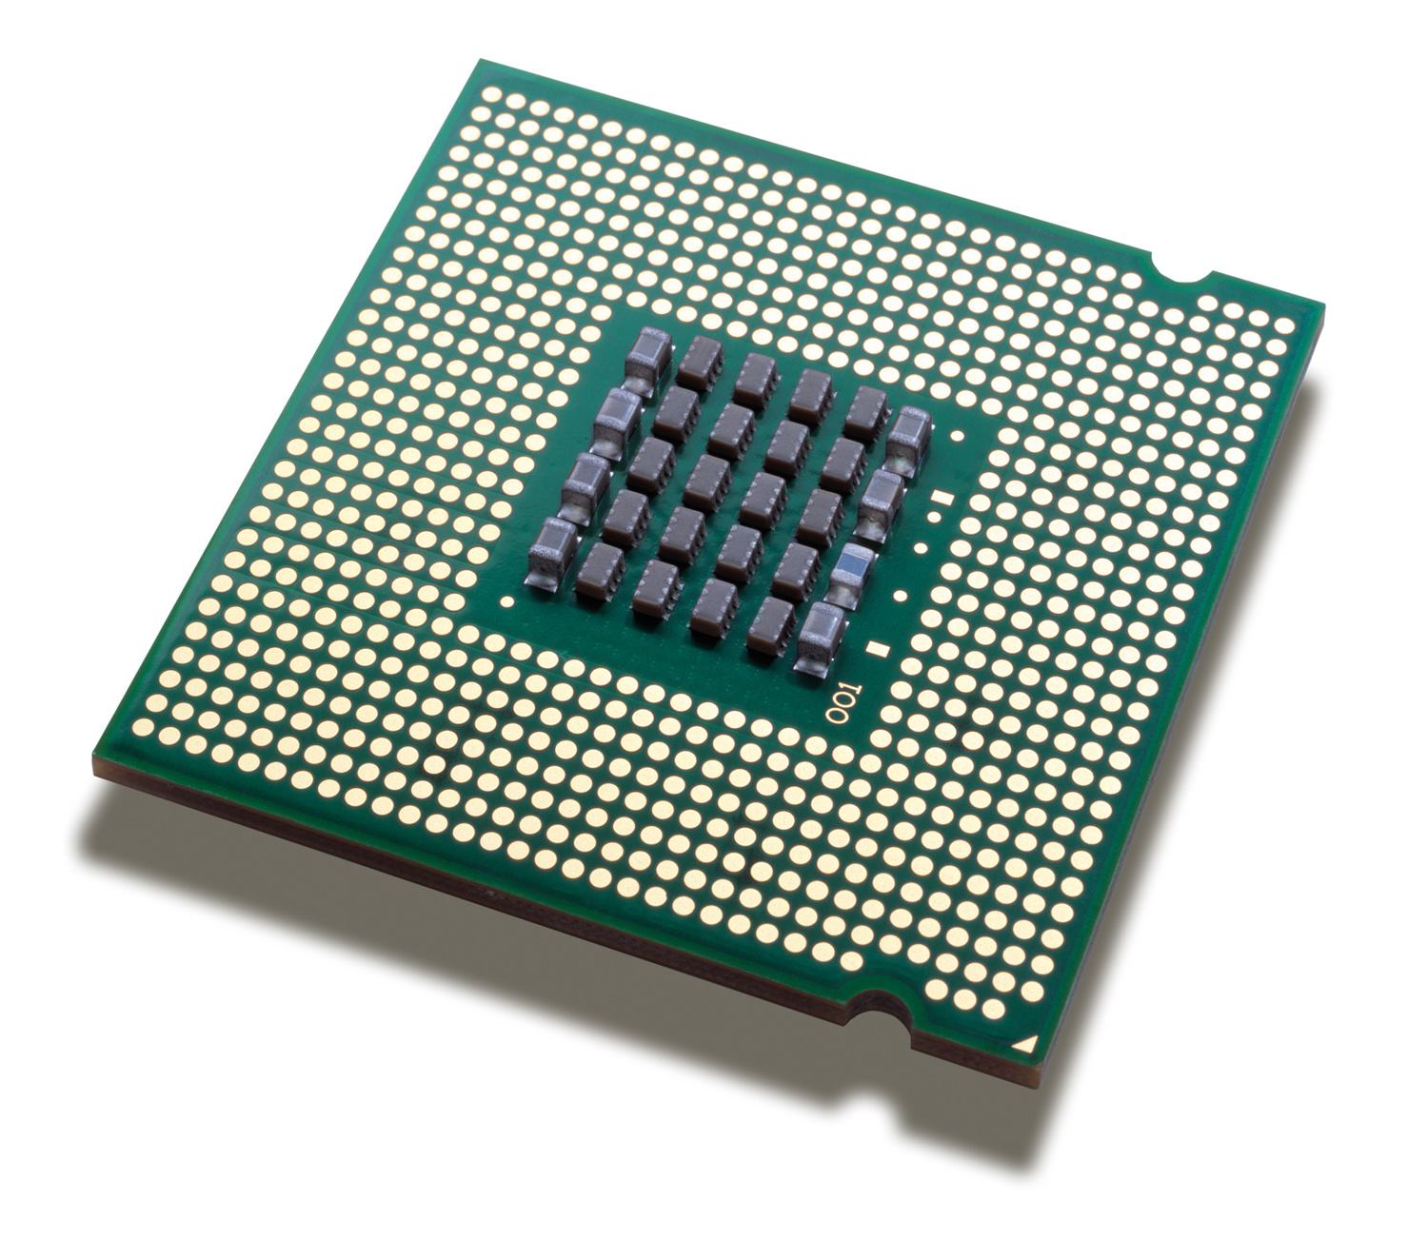
Micro-processor
1971
0.1 MIPS
4 bits
You all know
A micro-processor is:
CPU only
What is in your desktop, laptop, server, mobile
$$$
Optimized for processing power
Uses external ROM, RAM, peripherals, ...
Needs LOTS of power (and often cooling)
faster
2023
300 GIPS
64 bits

Slide 5
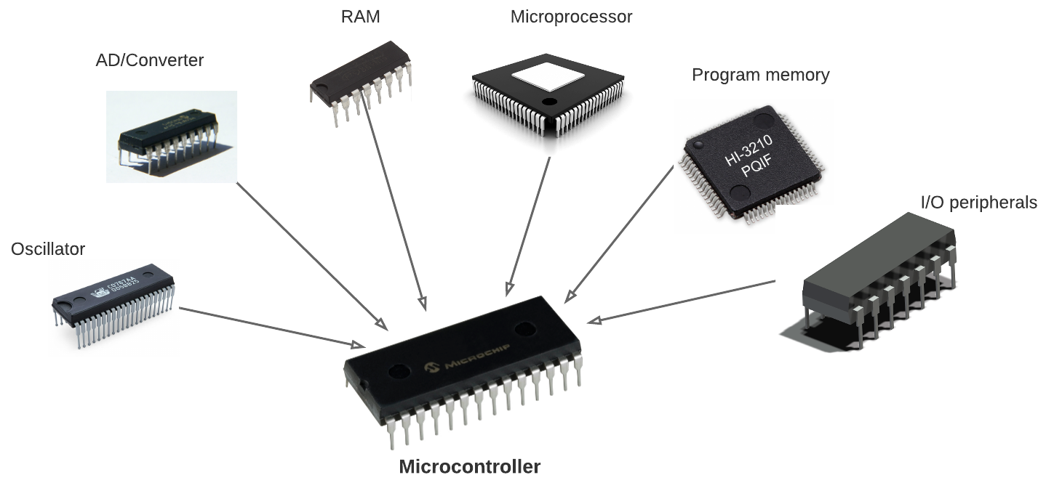
Micro-controller
1971
just the CPU
A micro-controller is
A single* chip with CPU, RAM, FLASH, I/O, …
Cheap, small, low-power
Used for embedded, real-time
(Much) less resources than a desktop
What you find in almost everything that is not a computer
You all know
Include more
(OK, a bit faster too)
2023
CPU, MMU
ROM, RAM
GPIO, A/D, D/A
I2C, SPI, I2S
….
If you can actually buy one….
* Next slide

Slide 6
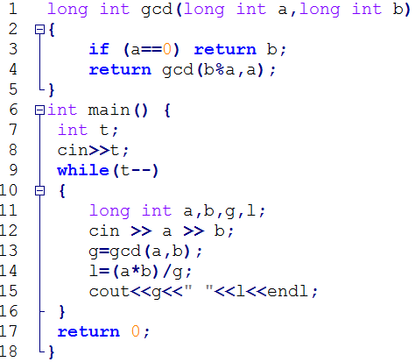


Interpreter
You all know
Interprets
Runs
Source code
Interpreter
CPU
interaction

Slide 7
Compiler
Translates
Runs
You all know
Source code
Compiler
Runs
CPU
interaction
Application

Slide 8
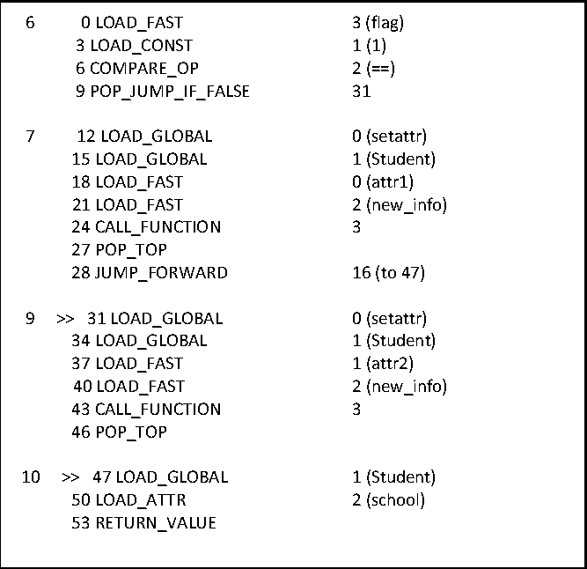
Compiler / Interpreter
Compiler
Translates
Runs
You all know
Source code
Runs
CPU
Interprets
interaction
Intermediate code
Interpreter / Virtual Machine

Slide 9
Compiler ⬅➔ Interpreter
You all know
Compiler translates (and validates)
Processor or interpreter executes the result of the translation
High-performance languages (typically) compile to CPU instructions (‘run native’)
Python (typically) compiles to Python byte-code
Which is then interpreted by the Python byte-code interpreter

Slide 10


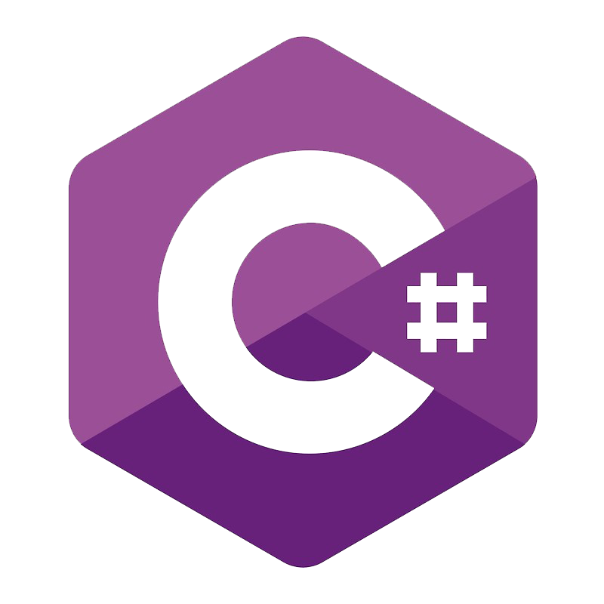


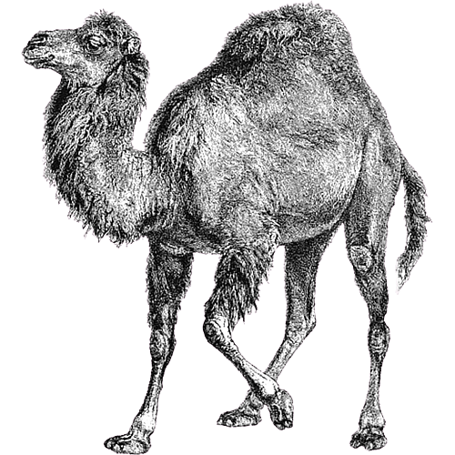







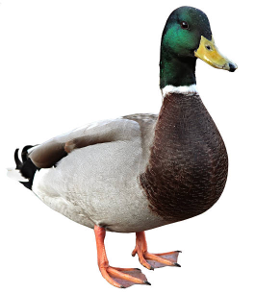
3 broad groups of languages
Writes faster, easier on small programs
Typing | Run-time |  |  | Compile-time
Compiles to | Intermediate (interpreter) |  |  | Native (CPU)
Memory Management | Automatic (run-time) |  |  | Manually (programmer)
Runs faster, easier on large programs

Slide 11
Python’s place
Run-time typed, memory managed ‘scripting’ languages:
Make it easy to do things that ought to be simple.
The programming language for the rest of the population.
Programming for non-programmers.
Get results quickly.*
(at the cost of run-time performance)
Not ideal for larger applications.
High-performance languages:
Get the best run-time performance
Optimize for large, complex applications.
(at the cost of programmer education, coding/debugging time)
Not ideal for explorative work.

Slide 12

(C)Python
Source code
CPU

Slide 13

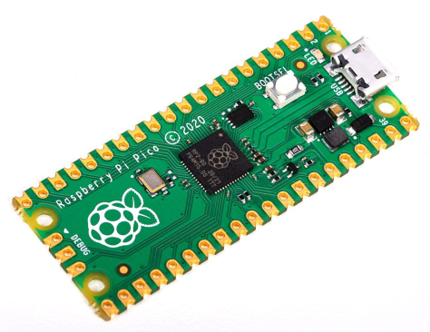
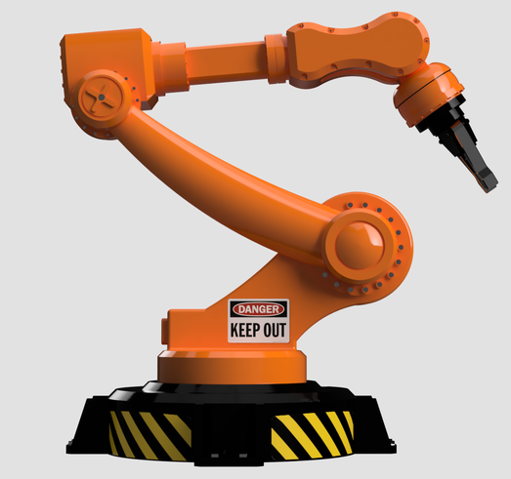
MicroPython
Thonny
Desktop CPU
On the PC
REPL
On the MC
MicroController
MicroPython

Slide 14
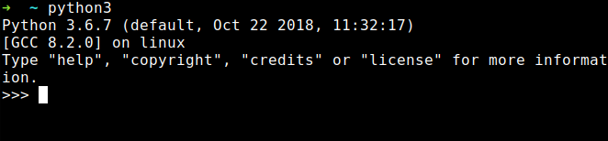
(Micro)Python REPL
Read-Evaluate-Print Loop:
Connects to your PC via serial-over-USB*
Read your input
Evaluate (run) it
Print the result
Repeat this forever
Acts as a primitive Operating System command interpreter
Provides a simple file system
Can interrupt a running program

Slide 15
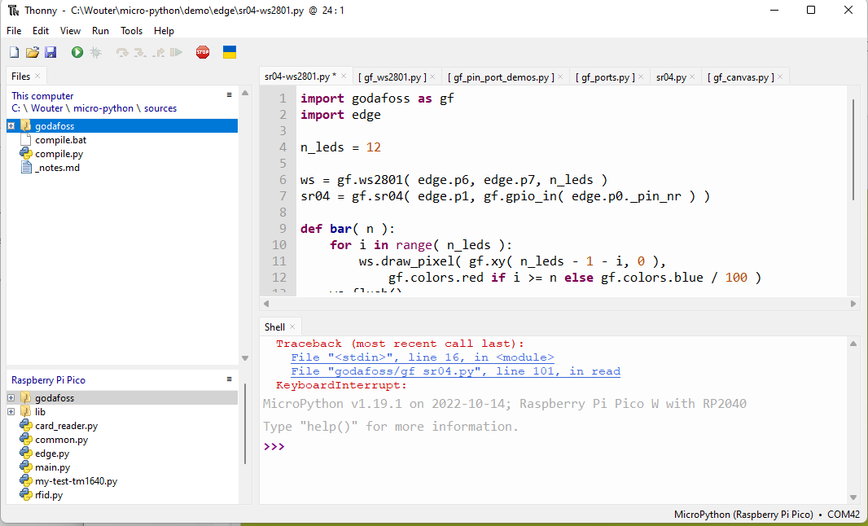
Thonny
Simple Python edit-run IDE
Can be configured to run remotely via REPL over (USB-) serial
Has very simple but useable file system views, with upload / download *
Can directly install MicroPython on some target chips
Editor is a bit primitive (I prefer Notepad++ for serious editing work)

Slide 16
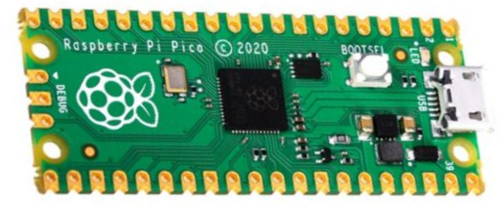
Demo install
Install by hand:
Connect Pi Pico USB while button pressed
RPI-RP (D:) drive shows up in explorer
Copy MicroPython image file to RPI-RP (D:)
Install using Thonny:
Again, Connect Pi Pico USB while button pressed
InThonny: Tools → Options → Interpreter
→ Select MicroPython (Rasberry Pi Pico)
→ Install or update MicroPython, variant H or HW
In thonny:
print ( “Hello” )

Slide 17
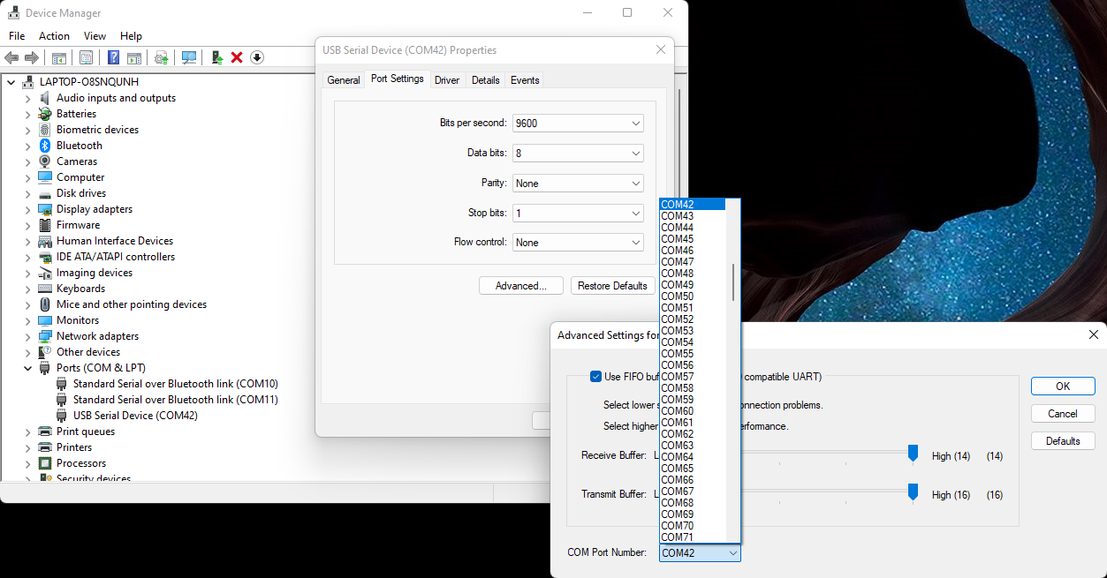
(rename serial port)

Slide 18
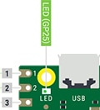
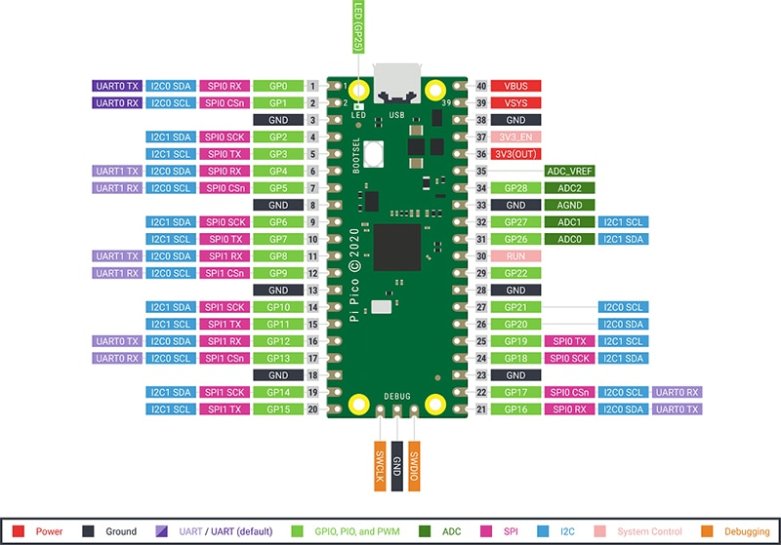
Demo on-board blinky
In Thonny REPL:
In Tonny editor:
from machine import Pin
led = Pin( 25, Pin.OUT )
led.value( 1 )
from machine import Pin
from time import sleep_us
led = Pin( 25, Pin.OUT )
while True:
led.value( 1 )
sleep_us( 500_000 )
led.value( 0 )
sleep_us( 500_000 )

Slide 19
Startup
boot.py runs first (at reset or power-up)
REPL STOP is a reset, and re-runs boot.py,
keyboard interrupt doesn’t re-run boot.py
Don’t mess with boot.py unless you really know what you are doing
main.py file runs after boot.py
REPL STOP doesn’t re-run main.py
keyboard interrupt doesn’t re-run main.py either
Put your startup line (import myapp.py) in main.py

Slide 20
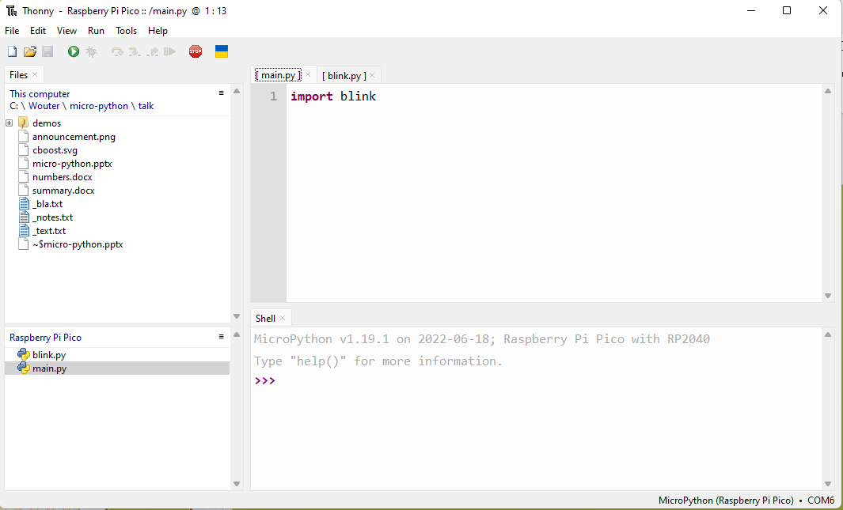
Demo startup
Save blink.py on the target
Create main.py on the target
Connect to power bank

Slide 21
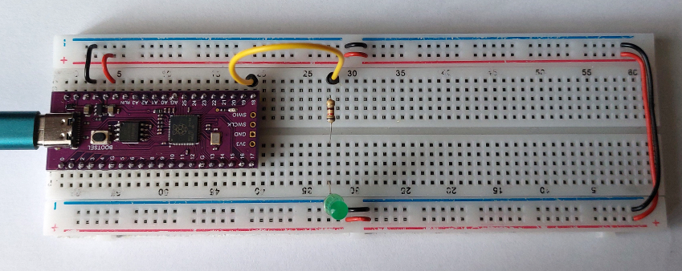
Demo external LED
from machine import Pin
from time import sleep_us
led = Pin( 28, Pin.OUT )
while True:
led.value( 1 )
sleep_us( 500_000 )
led.value( 0 )
sleep_us( 500_000 )

Slide 22
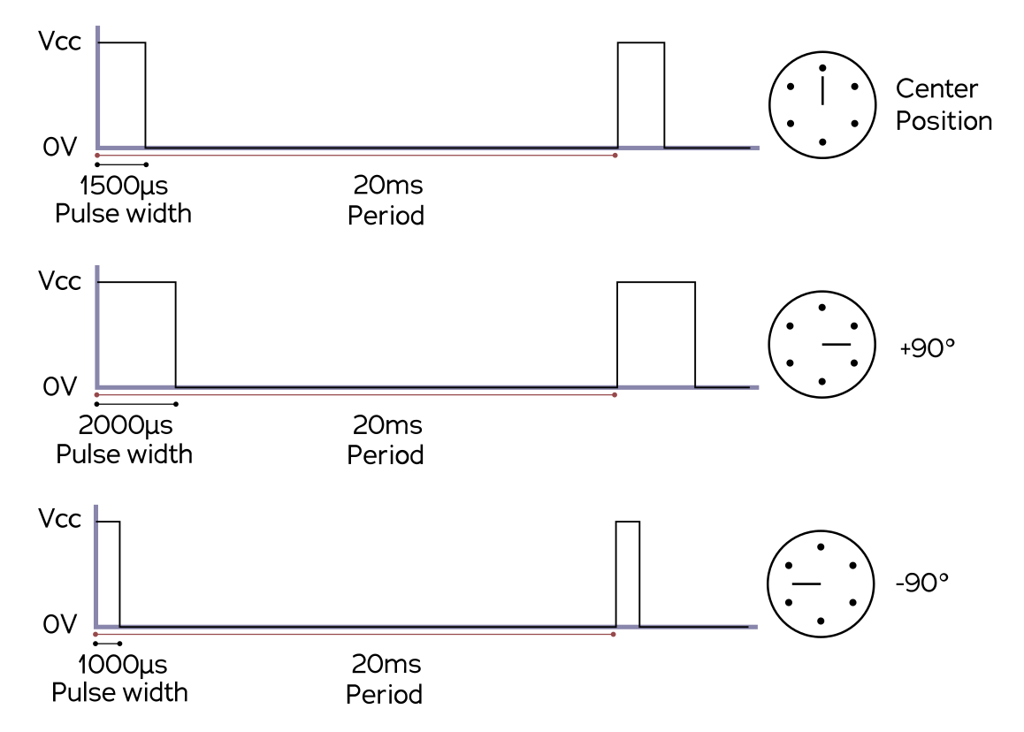
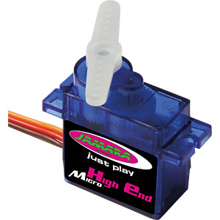
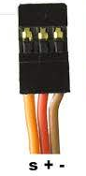
Servo control

Slide 23
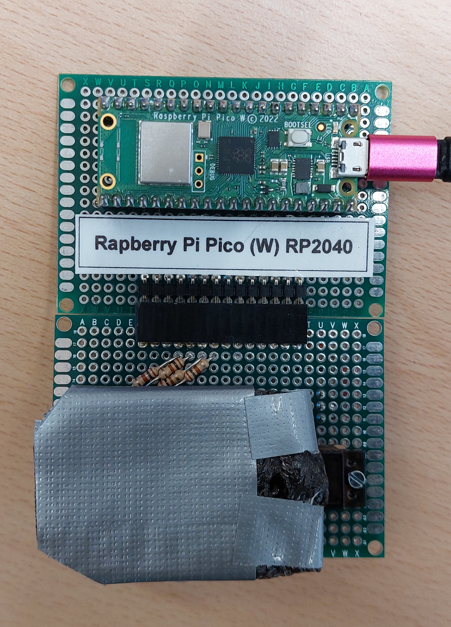
Demo servo
import godafoss as gf
edge = gf.edge()
green = gf.make_pin_out( edge.p0 )
...
leds = red & green & blue & yellow
leds.write( 1 )
servo = gf.servo( edge.p4 )
last = gf.ticks_us()
visible = True
while True:
now = gf.ticks_us()
if now - last > 500_000:
visible = not visible
last = now
servo.write( gf.fraction( 100 if visible else 0, 100 ) )

Slide 24
Servo control
t = ticks_us()
if t >= self._next:
self._pin.pulse(
self._value.scaled( self._minimum, self._maximum ),
0
)
self._next = t + self._interval
def pulse(
self,
high_time: int,
low_time: int = 0
) -> None:
self.write( True )
if high_time != 0:
sleep_us( high_time )
self.write( False )
if low_time != 0:
sleep_us( low_time )
Time scale is 1000 .. 2000 us:
well within MicroPython (busy!) waiting

Slide 25
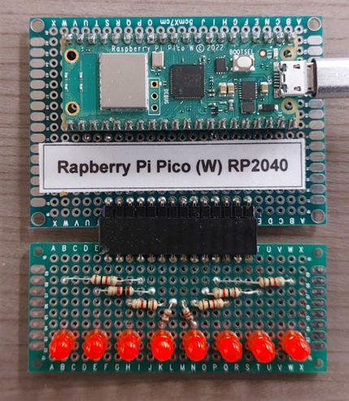
More LEDs!
import godafoss as gf
edge = gf.edge()
gf.kitt( edge.port().inverted() )

Slide 26
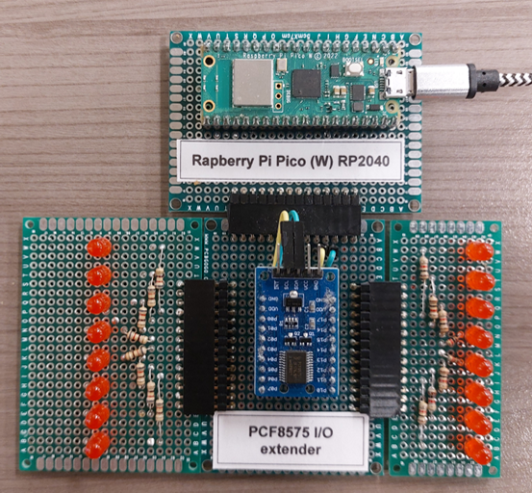
You still want more LEDs?
import godafoss as gf
edge = gf.edge()
chip = gf.pcf8575( edge.soft_i2c() )
gf.kitt( chip.inverted() )
import godafoss as gf
edge = gf.edge()
chip = gf.pcf8575( edge.soft_i2c() )
gf.kitt( chip.inverted(), interval = 10_000 )

Slide 27
3 ways to load Python code
3 ways to work on and use a library
As (.py) sources
As (.mpy) pre-compiled code
As frozen (.mpy) code in the image
Compare using
Pi Pico RP2040 (without W)
MicroPython v1.19.1
Thonny for upload (USB-serial)
My feeble laptop for building
My godafosss library code (nov 2022), with on-demand loading (85 files, 471 Kb, heavily commented)

Slide 28
Embedding (freezing) code
FROM ubuntu
RUN apt update
RUN apt install -y build-essential git make python3
RUN apt install -y cmake gcc-arm-none-eabi libnewlib-arm-none-eabi
WORKDIR /work
RUN git clone https://www.github.com/micropython/micropython
WORKDIR /work/micropython
RUN make -C mpy-cross
RUN git submodule update --init -- lib/pico-sdk
RUN git submodule update --init -- lib/tinyusb
WORKDIR /work/micropython/lib/pico-sdk
RUN git submodule update –init
WORKDIR /work/micropython/ports/rp2
RUN make board=PICO submodules
WORKDIR /work/micropython/ports/rp2/modules
COPY modules .
WORKDIR /work/micropython/ports/rp2
RUN make board=PICO
Download sources + dependencies
Install tooling
Put your files in the correct location
Follow the instructions carefully
Worked for me on Ubuntu, but not on WSL
Use Docker! (demo)

Slide 29
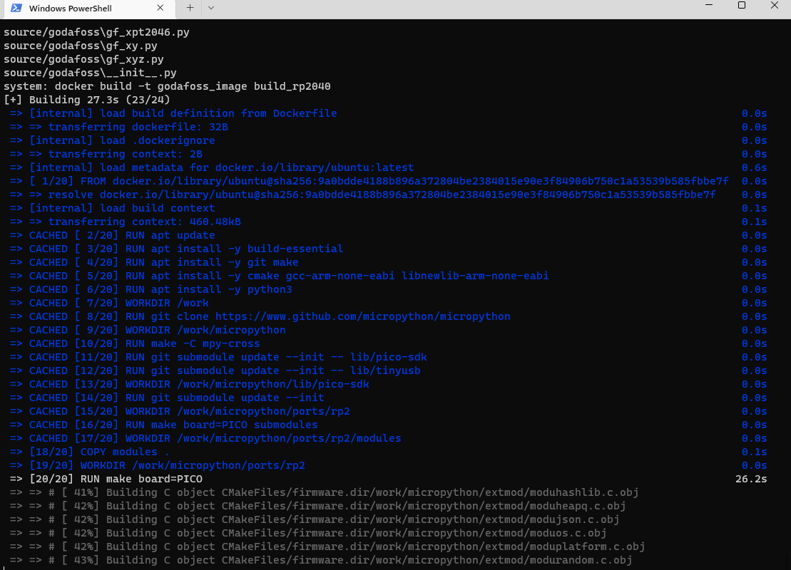
Embedding (freezing) code
Life, if time permits
Takes 40 – 200 s

Slide 30
Some numbers
Pi Pico (RP2040) Way => Aspect | Sources | Pre-compiled | Frozen
Get it there | 60 s upload | 120 s cross-compile 20 s upload | 40 – 400 s build 20 s install
Loading time | 12 s | 9 s | 1.7 s
RAM footprint | 54 Kb (126 Kb free) | 54 Kb (126 Kb free) | 31 Kb (154 Kb free)
Edit / run | ++ | - | --
For development, maybe just use a faster / larger target….
Teensy 4.1 (iMXRT1062) | Sources
Loading time | 1 s
RAM footprint | 54 Kb (700 Kb free)

Slide 31
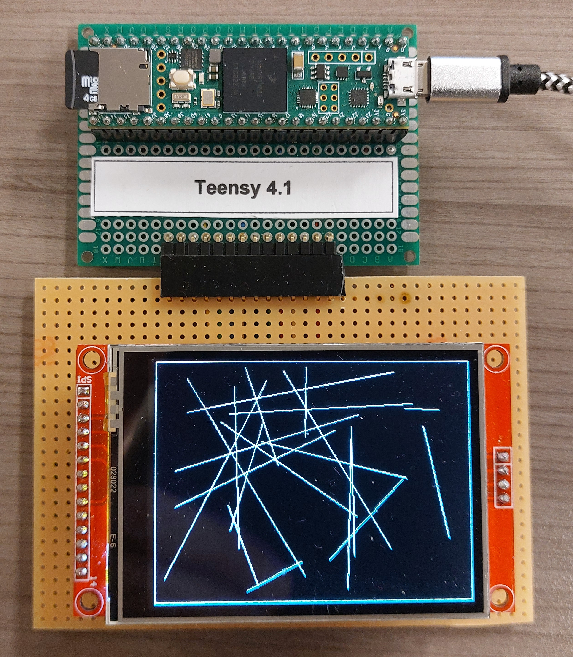
Use a faster chip
DEMO:
Teensy 4.1 screen demo lines etc
Loads very fast!

Slide 32
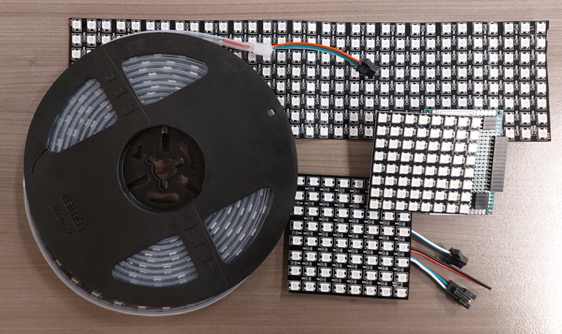
I still want more LEDs
Demo:
Neopixels strip
Neopixels 8 * 8 PCB
Neopixels 8 * 8 flex
Edit source
Neopixels 32 * 8 flex
Neopixels 8 * 8 + 32 * 8

Slide 33
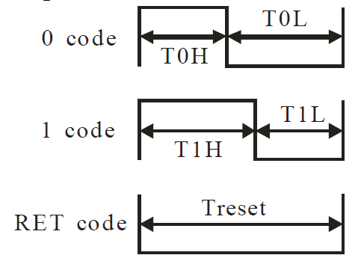
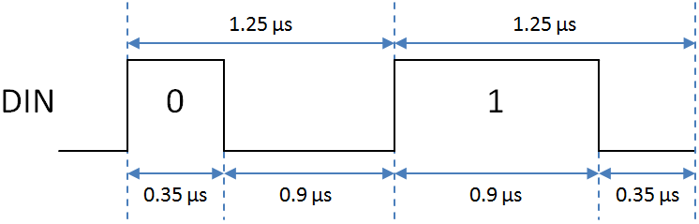
Neopixel protocol
Time scale is 0.35 .. 1.25 us: well OUTSIDE what can be done in MicroPython
-> must be built into the interpreter (…)

Slide 34
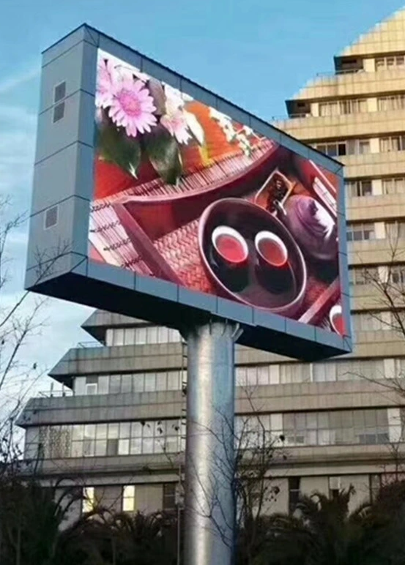
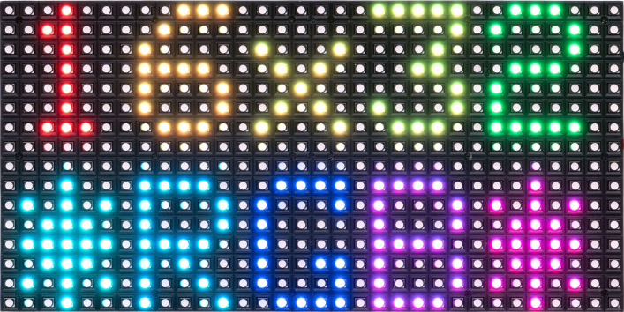
Even more LEDs?

Slide 35
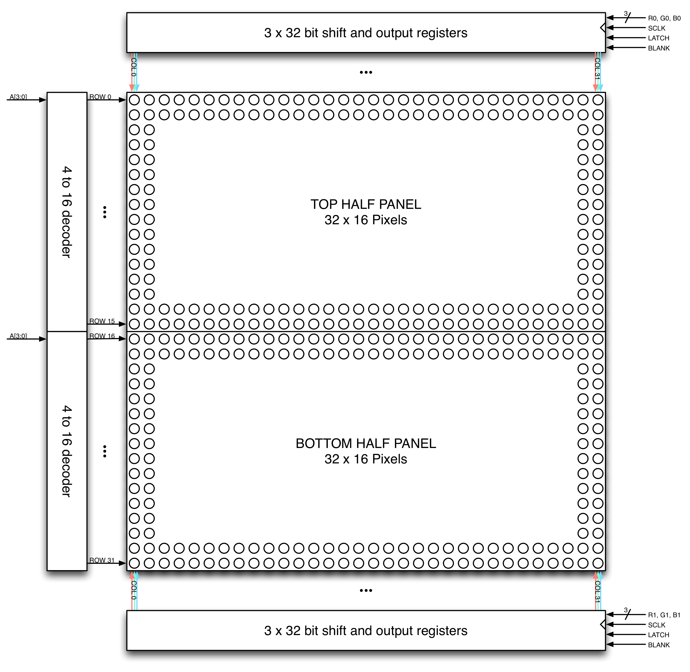
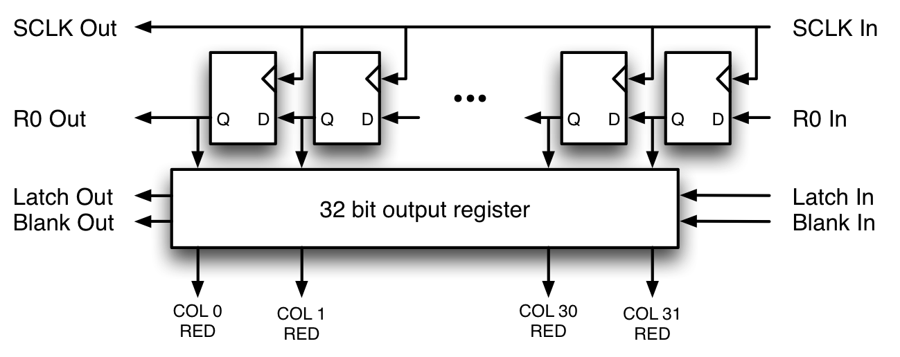
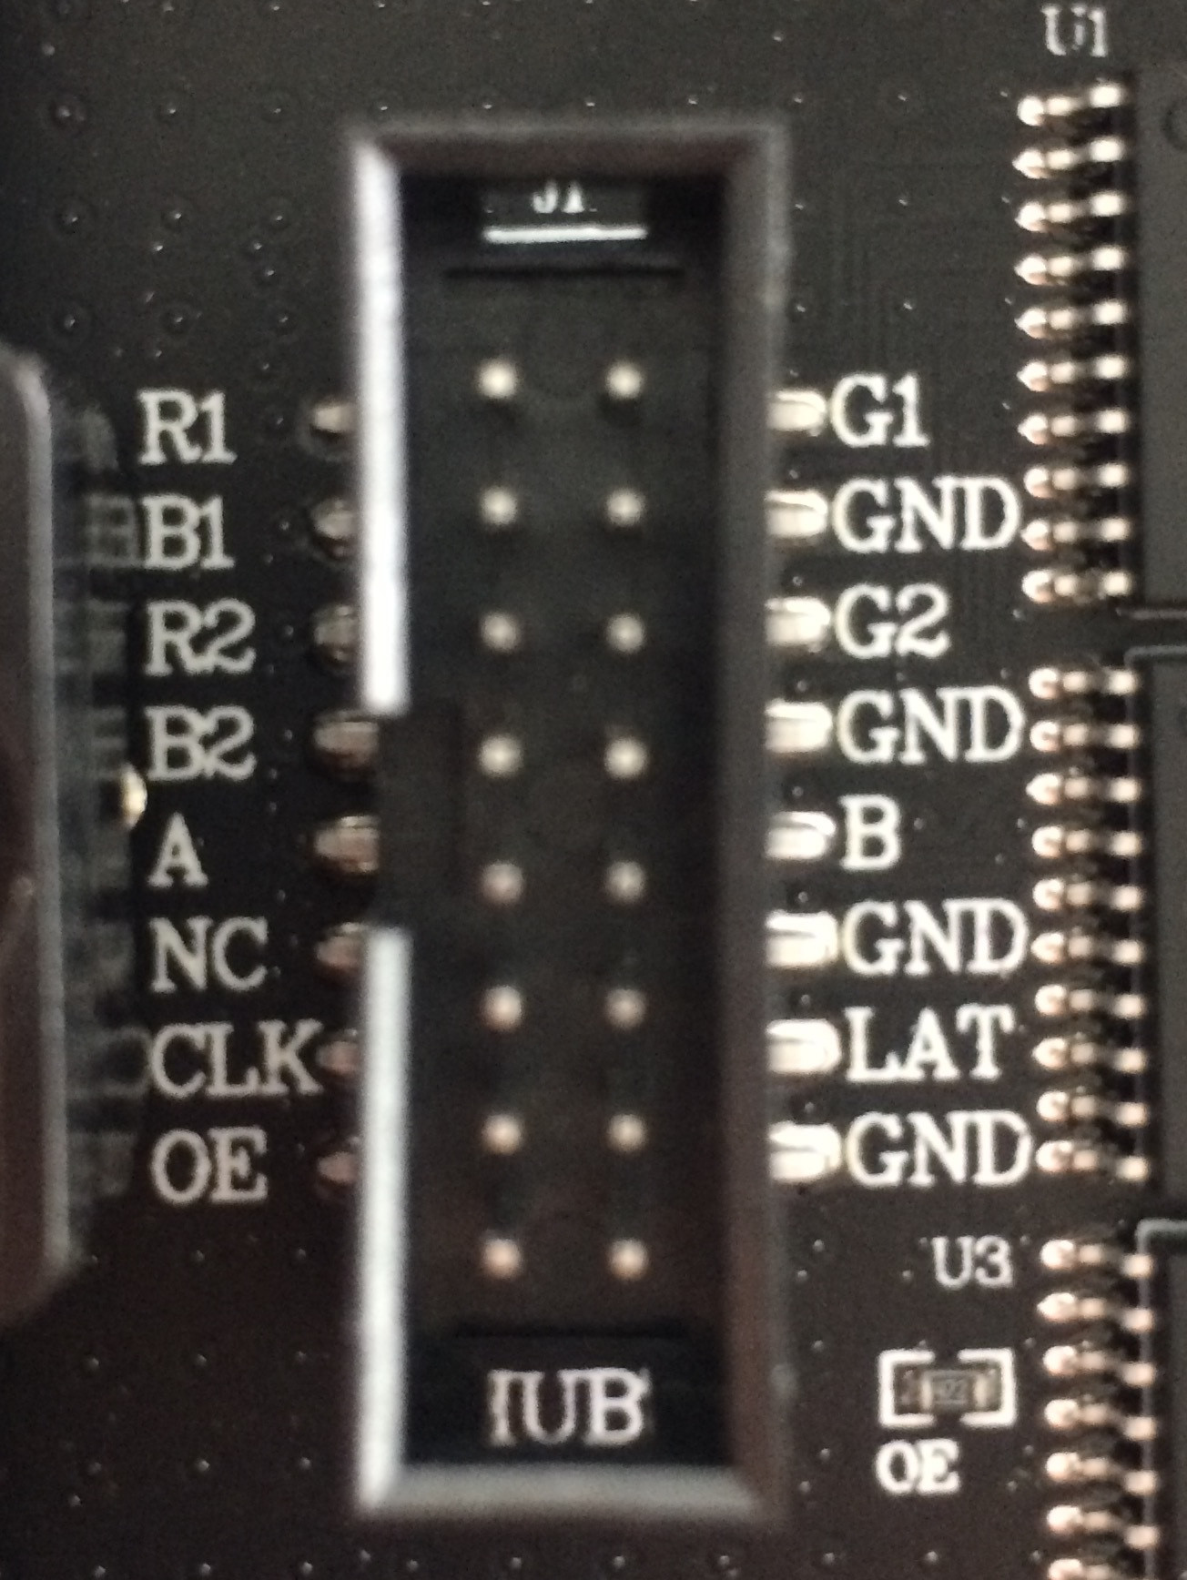
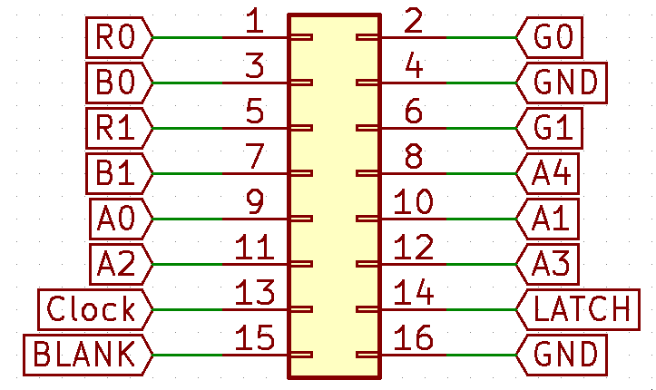
HUB75 interface

Slide 36
HUB75 interface
2 panels in series: 64 x 32 pixels x 3 colors = 6144 bits
Refresh @ 100 Hz -> ~ 614 k bits/sec (3 bits color)
5 bits color depth (15 bit color): * 32 = ~ 20 M bits/sec
(6 bits/clock so clock is // 6)
Continuously!
Not realistic in Python, interesting in C/C++/Rust
but …

Slide 37
HUB75 interface
For 16 lines
For 64 pixels
Output 6 color bits to R1…B2 pins
Toggle shift register clock
Disable output
Toggle output register clock
Output line number on A…E pins
Enable output

Slide 38
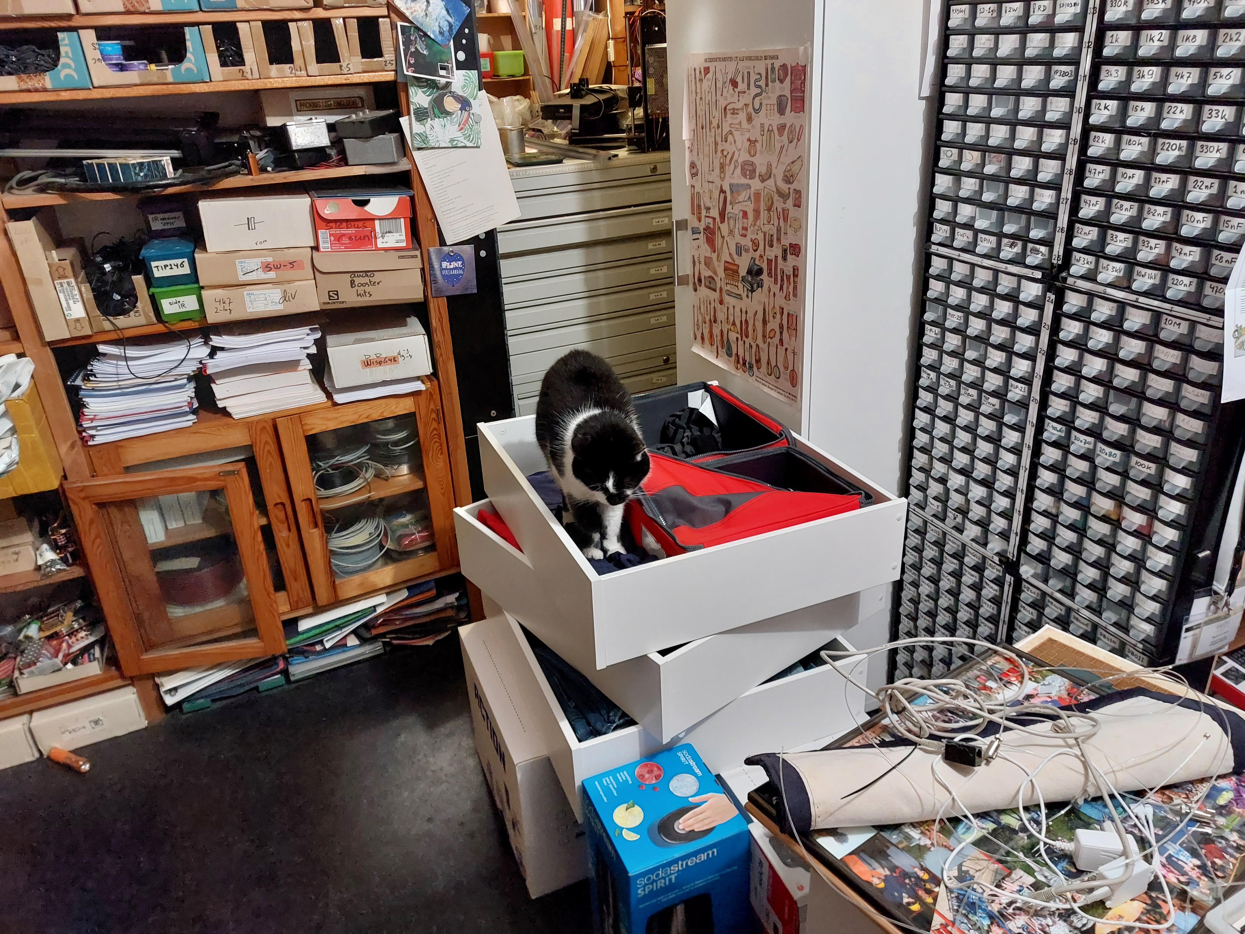
Mandatory cat

Slide 39
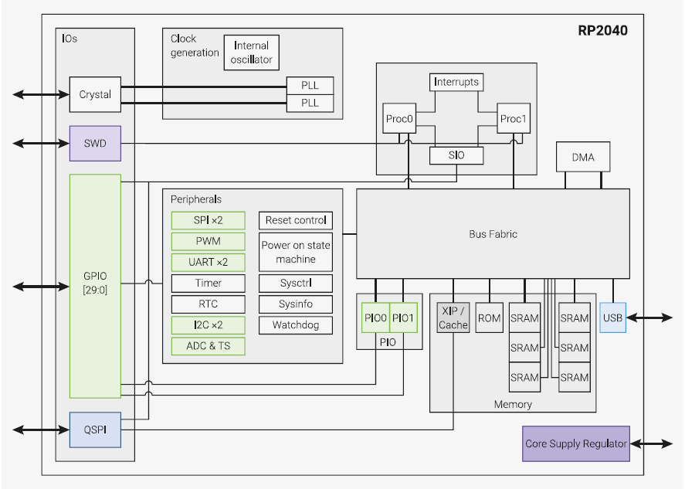
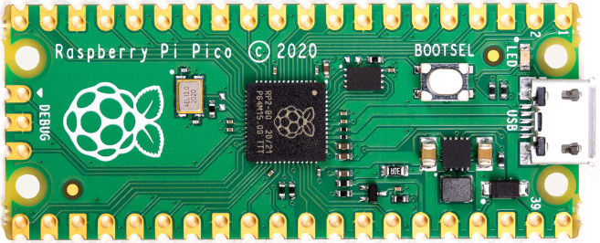
RP2040

Slide 40
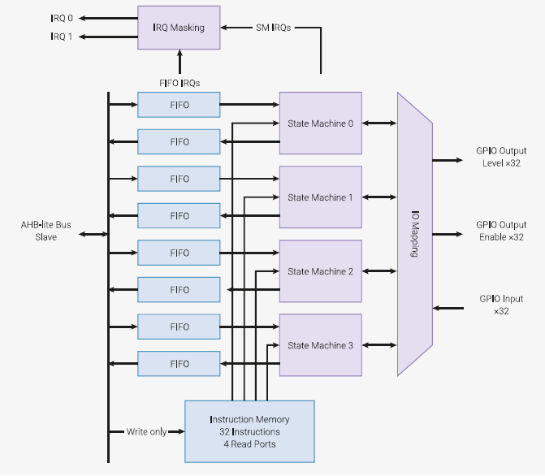
RP2040 PIO
2 PIO, each PIO has
32 x 16 bit instruction memory
4 state machines, each state machine has
Clock divider
Interrupts
2 * 4 x 32 bit FIFOs
4 groups of (consecutive) GPIOs:
Shift inputs, shift outputs
Set outputs, side-set outputs

Slide 41
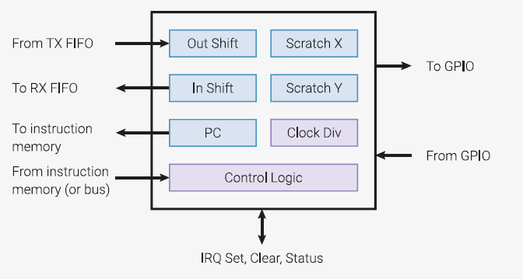
RP2040 PIO state machine
Each state machine has
32 bit input shift register
32 bit output shift register
X, Y: 32 bit scratch registers

Slide 42
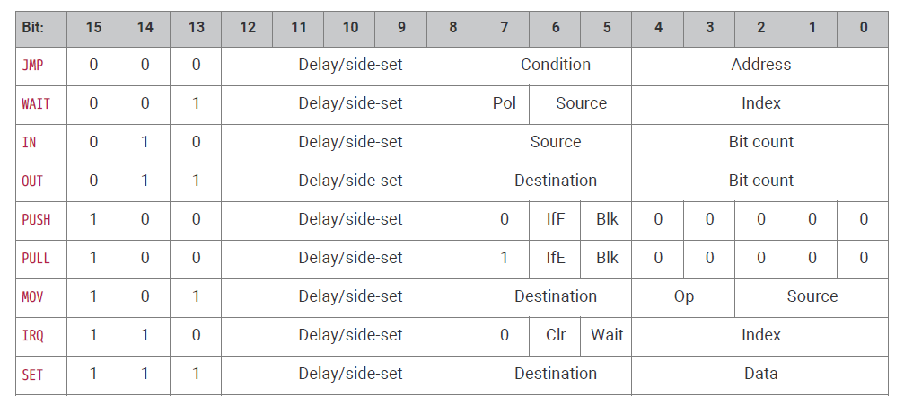
Instruction set

Slide 43
HUB75 PIO code
HUB75 display
PIO engine
GPIOs
For 16 lines
For 64 pixels
Pull new bits from FIFO
Output 6 to R1…B2 pins
Toggle clock
Disable output
Clock new data into holding latch
Output line number on A…E pins
Enable output
pull()
mov( x, osr )
label( "bitloop" )
out( pins, 8 ).side( 0 + 0 + 0 )
jmp( x_dec, "bitloop" ).side( 0 + 0 + 1 )
nop().side( 4 + 2 + 0 ) # oe = 1, lat = 0
pull()
out( exec, 32 )

Slide 44
Ping-pong DMA
Needs continuous DMA from the pixel buffer to the PIO engine
DMA 0 does the actual data transfer
source address increment, destination fixed
At the end of its transfer it triggers DMA 1
DMA 1 transfers 1 word to the DMA 0 source trigger address
Source address fixed, destination address fixed
def dma_poke(
channel: int,
offset: int,
value: int
):
machine.mem32[ 0x50000000 + channel * 0x40 + offset ] = value
# DMA channel that transfers the _pio_buffer
# to the pio state machine
dma_poke( 1, 0x00, uctypes.addressof( self._pio_buffer ) )
dma_poke( 1, 0x04, 0x50200010 )
dma_poke( 1, 0x08, len( self._pio_buffer ) // 4 )
dma_poke( 1, 0x10,
( 0x0 << 15 ) | ( 0 << 11 ) | ( 1 << 4 ) | ( 2 << 2 ) | 1 )
DMA 0
DMA 1
pixel buffer
PIO engine

Slide 45
Data format translation
The PIO engine needs a format (r0g0b0r1g1b1) that is quite different from a standard Micropython graphic framebuffer (2 byte RGB)
Translating in PIO code is impractical
Translating in Python is quite slow (especially the bit fiddling)
@micropython.native
buffer_pointer = . . .
for y in range( size_y // 2 ):
for x in range( self.size.x ):
a = pixel( x, y )
b = pixel( x, y + size_y // 2 )
mem8[ buffer_pointer ] = encode( a, b )
buffer_pointer += 1
flush
@micropython.viper
def encode( a: uint, b: uint ) -> uint:
d = uint( 0 )
if ( a & uint( 0x0F00 ) ): d += uint( 1 )
if ( a & uint( 0x00F0 ) ): d += uint( 2 )
if ( a & uint( 0x000F ) ): d += uint( 4 )
if ( b & uint( 0x0F00 ) ): d += uint( 8 )
if ( b & uint( 0x00F0 ) ): d += uint( 16 )
if ( b & uint( 0x000F ) ): d += uint( 32 )
return d
framebuffer
pixel buffer

Slide 46
Total picture
encode
application
flush
DMA 0
DMA 1
framebuffer
pixel buffer
PIO engine
GPIOs
HUB75 display
Python
viper
memory
RP2040 hardware
Python for application logic
RP2040 hardware for the high-speed part (HUB75 limited)

Slide 47
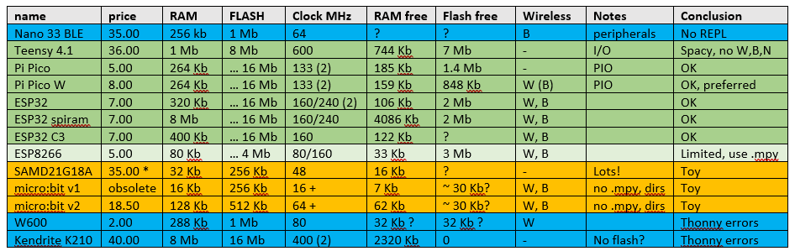
Some target chips/boards

Slide 48
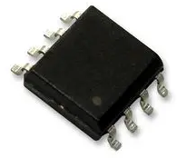
Hybrids
Micro-processor
Micro-something
Micro-controller
CPU
CPU
CPU
RAM
RAM
RAM
RAM
ROM
ROM
ROM
ROM
PERIPHERALS
PERIPHERALS
PERIPHERALS
ESP8266, ESP32, RP2040

Slide 49

RAM
RAM is scarce, the Python is hungry
Split into smaller files to avoid peak RAM use
Use demand-loading (code)
Use pre-compiled files (mpy-cross)
Incorporate (pre-compiled) library files into the MicroPython image (demo)
Use a big fat fast target chip for development

Slide 50
On-demand loading
from submodule import classname
def classname( *args, **kwargs ):
from submodule import classname
return classname(*args, **kwargs )
One trampoline takes ~ 50 bytes
The real code is a bit more complicated

Slide 51
Limitations
Uses a lot of RAM, especially for an LCD graphic buffer
Speed is low (compared to running native code) and can be unpredictable (garbage collection)
Some timing-based HW interface protocols (neopixels, dallas one-wire, DHT11) are not feasible in native Python
Some doubts about running longer time (memory fragmentation), needs occasional 2nd start ☹
Needs more expensive hardware (than a native-code application)
Might use more power (than a native-code application)
Organization is MUCH smaller than python.org (hobbyistic)
Some standard libraries are not available and/or impractical (CPU & memory load)
Not all ports are equal (especially in WiFi details and built-in HW libraries)
No multi-threading (except when multiple CPUs are available)
Type hints not implemented yet

Slide 52
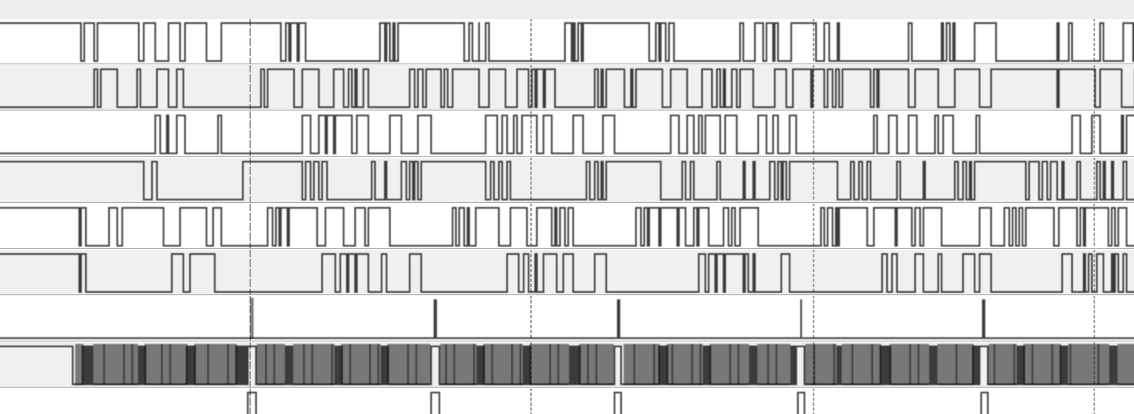
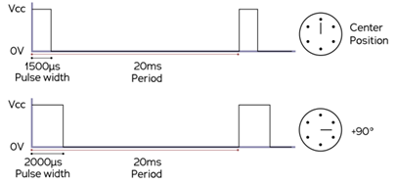
Timin, performance
How much time do you have to do something simple?
1’s of clock cycles: use hardware peripherals, assembler, RP2040 PIO’s
10-100’s of clock cycles : can also use C, C++, Rust
1000’s of clock cycles: can also use MicroPython
HUB75: 20 MHz, 60 Mbits/s
(~ 1ns /bit)
Neopixel: 0.35 – 0.9 µS
Servo: 1000 – 2000 µS

Slide 53
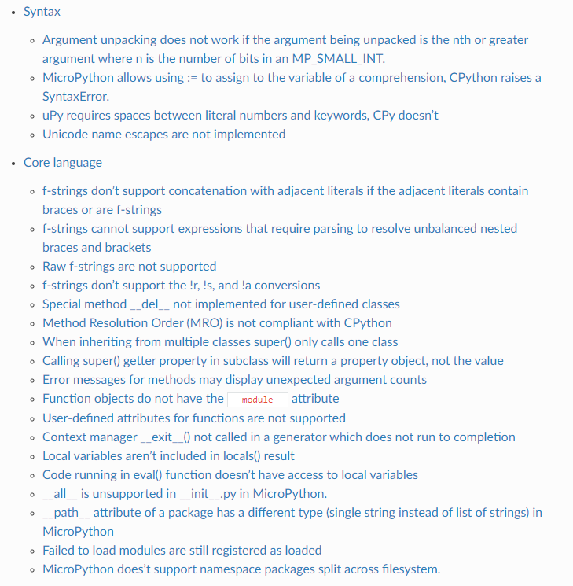
Deviations from CPython
Source: https://docs.micropython.org/en/latest/genrst

Slide 54
Licenses…..
Embedded systems (often) don’t have a console, splash screen, help tab, manual
Are often deeply embedded into something
Licenses that require attribution are a PITA for embedded systems
Prefer a totally free license (C++: boost)
My library: MIT (because it is well-known)
What does that even mean for compiled code??
To be on the safe side….
The above copyright notice and this permission notice shall be included in
all copies or substantial portions of the Software.

Slide 55
Application areas
When faster development outweighs the extra hardware cost:
Tinkering (hobby, education, exploratory work, lab setting)
Prototyping, proof-of-concepts, demos
Testing
Small series
When a somewhat knowledgeable end-user must do some tweaking

Slide 56
Caveats
Where is my code? Be sure to save your work on your PC (too)!
USB can supply only a limited amount of current
Upload, download confusion
Some chips claim MicroPython support but don’t fully deliver (W600, K210).
An uploaded file is sometimes not recognized as newer? (solution: add a space and upload again)
Thonny sometimes crashes (especially on communication problems – don’t pull the cable!)
Different MicroPython versions and ports can be subtly different (like no neopixels on Teensy)
Want to protect your IP? Probably forget it.

Slide 57
Not covered
Wireless REPL (WiFi)
Mass-storage emulation (PyBoard, Teensy 4.1)
Thonny alternatives
CircuitPython: proprietary variation by AdaFruit, very similar but some (irritating) differences
Extending MicroPython by embedding native code in the interpreter (C, C++)

Slide 58
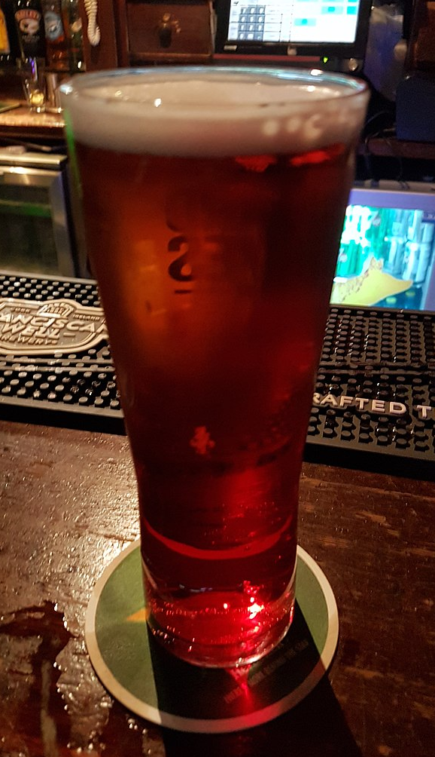
Snakebite
from functools import reduce
def plus_one( x, y = [ 1 ] ):
y.append( x )
return reduce(
lambda a, b: a + b,
y
)
print( plus_one( 1 ) )
print( plus_one( 2 ) )

Slide 59

Antidote
class immutable:
_frozen = False
def __init__( self ) -> None:
self._frozen = True
def __delattr__( self, *args, **kwargs ):
if self._frozen:
raise TypeError( "immutable object" )
object.__delattr__( self, *args, **kwargs )
def __setattr__( self, *args, **kwargs ):
if self._frozen:
raise TypeError( "immutable object" )
object.__setattr__( self, *args, **kwargs )
class xy( immutable ):
def __init__(
self,
x: int,
y: int
) -> None:
self.x = x
self.y = y
immutable.__init__( self )

Slide 60

Takeaway?
More LEDs is better.
Micropython can be a nice addition to your toolset.

